Slide 1
Introduction to Classes 1
C# Version

Slide 2
Music Store Inventory
Assume that we have been hired by a music store to create a computer system to manage inventory
One thing we need to do is model a guitar in computer code
We will use Microsoft Visual Studio to write the code in the C# programming language

Slide 3

Required Data
We begin by asking the store owner to tell us what data is required to model a guitar in our computer system
The first thing the owner tells us is to
include the serial number of each guitar
There is more data that needs to be
tracked, but let's focus on the
serial number first

Slide 4
Guitar Serial Numbers
We need to do some research
How long are guitar serial numbers?
Do guitar serial numbers contain letters and numbers or just numbers?
We can ask the store owner for his understanding of the length and composition of guitar serial numbers
We can look for information on the web:
Information about Fender guitar serial numbers can be found at:
http://www.fender.com/en-CA/support/articles/u-s-instruments-product-dating/
Information about Gibson guitar serial numbers can be found at:
http://www.gibson.com/Files/downloads/bluebook/gibsonserialnumbers.pdf
Information about Reverend guitar serial numbers can be found at:
http://www.reverendguitars.com/archives/serial-numbers-guitar-and-bass/

Slide 5



Guitar Serial Numbers
L94075
03284647
10050

Slide 6
Guitar Serial Numbers
Through our research we find that guitar serial numbers vary in length and can contain both numbers and letters
This tells us that we should use the string data type to store guitar serial numbers
In programming a “string” is a string of characters, or in other words text
Strings can contain letters and numbers – and also punctuation and symbols
A string can store the longest guitar serial number with room to spare

Slide 7
Variables
When our program is running a guitar serial number will be stored in a string variable
A variable is a named chunk of computer memory that holds a value of a certain data type
It is called a ”variable” because different values can be stored in it as a program executes
In C# the variable declaration we need looks like this:
string serialNumber;
String is the data type, serialNumber is the variable name or identifier, and the semi-colon marks the end of the statement

Slide 8
Assignment Statements
We can store a value in the variable with an assignment statement like this:
string serialNumber = "L94075";
This statement assigns the literal string “L94075” to the serialNumber variable

Slide 9
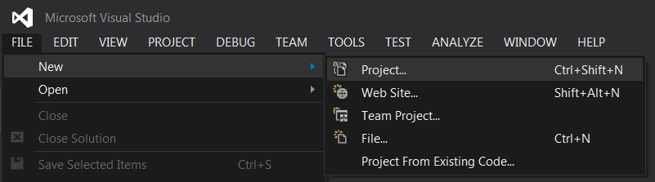
Basic C# Console Application - 1
Run Visual Studio and create a new project

Slide 10
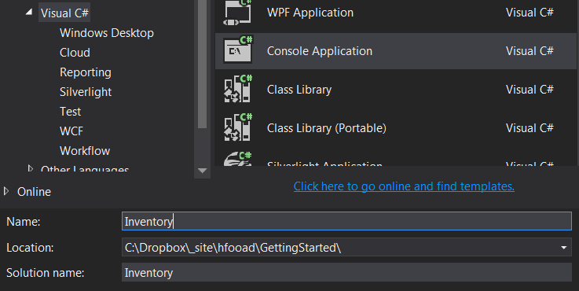
Basic C# Console Application - 2
Create a C# console application on your G: drive

Slide 11
Basic C# Console Application – 3a Explanation
We will add C# code to the Main() method to:
Declare a variable
Assign a value to the variable
Show the value on the console

Slide 12
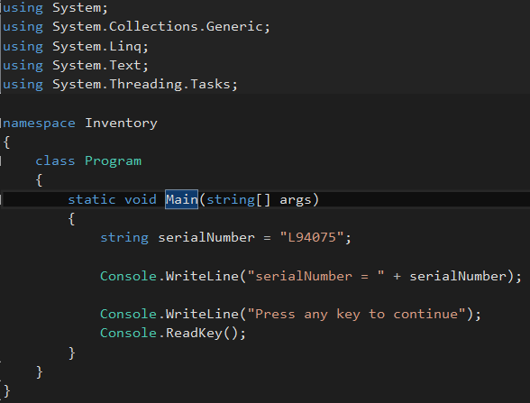
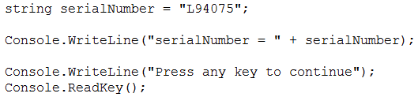
Basic C# Console Application – 3b Screen Capture
Enter the code below or copy and paste it from the next slide

Slide 13
Basic C# Console Application – 3c Copyable Code
string serialNumber = "L94075";
Console.WriteLine("serialNumber = " + serialNumber);
Console.WriteLine("Press any key to continue");
Console.ReadKey();

Slide 14
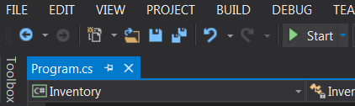

Basic C# Console Application – 3d Output
Start the application
The output will be displayed in a console window
Press any key to close the console window
Click Start

Slide 15
Input and Output – 1a Explanation
We will add C# code to the Main() method to:
Declare a variable
Read a value from the console
Assign the value to the variable
Show the value on the console

Slide 16
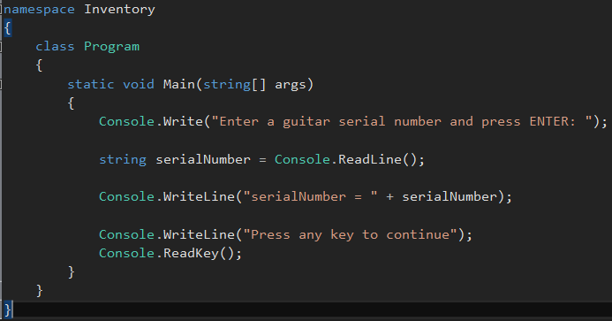
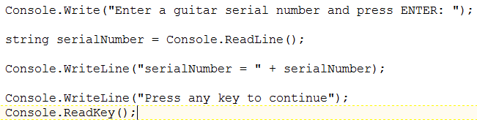
Input and Output – 1b Screen Capture
Enter the code below or copy and paste it from the next slide

Slide 17
Input and Output – 1c Copyable Code
Console.Write("Enter a guitar serial number and press ENTER: ");
string serialNumber = Console.ReadLine();
Console.WriteLine("serialNumber = " + serialNumber);
Console.WriteLine("Press any key to continue");
Console.ReadKey();

Slide 18
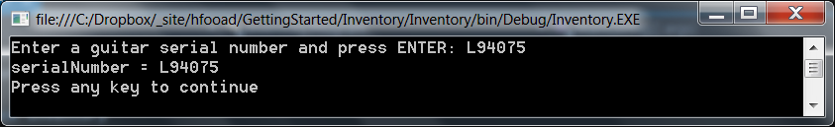
Input and Output – 1d Output
Start the program and enter a guitar serial number to assign to the serialNumber variable

Slide 19
Input and Output – 2a Explanation
We will add C# code to the Main() method to:
Declare a variable
Read a value from the console
Assign the value to the variable
Show the value on the console
Repeat steps 2-4 for two more values

Slide 20
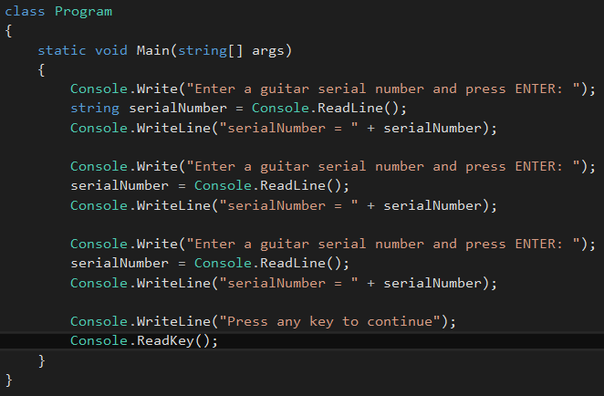
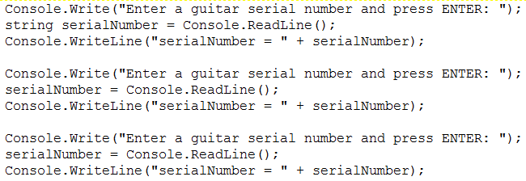
Input and Output – 2b Screen Capture
Enter the code below or copy and paste it from the next slide

Slide 21
Input and Output – 2c Copyable Code
Console.Write("Enter a guitar serial number and press ENTER: ");
string serialNumber = Console.ReadLine();
Console.WriteLine("serialNumber = " + serialNumber);
Console.Write("Enter a guitar serial number and press ENTER: ");
serialNumber = Console.ReadLine();
Console.WriteLine("serialNumber = " + serialNumber);
Console.Write("Enter a guitar serial number and press ENTER: ");
serialNumber = Console.ReadLine();
Console.WriteLine("serialNumber = " + serialNumber);
Console.WriteLine("Press any key to continue");
Console.ReadKey();

Slide 22
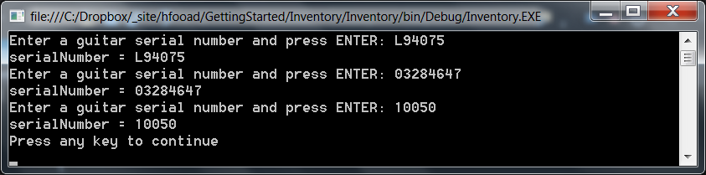
Input and Output – 2d Output
Start the program and enter different serial numbers to be assigned to the serialNumber variable

Slide 23
Input and Output – 3a Explanation
We will add C# code to the Main() method to:
Declare a variable for a Fender serial number
Read a value from the console
Assign the value to the Fender serial number variable
Repeat steps 1-3 for a Gibson serial number
Repeat steps 1-3 for a Reverend serial number
Show all three serial numbers on the console

Slide 24
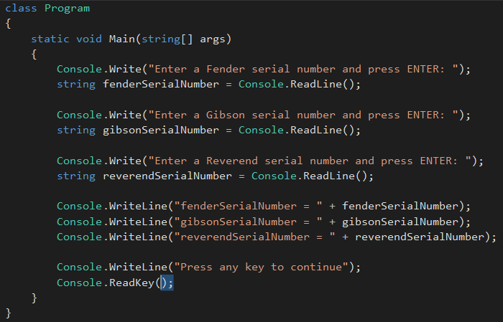
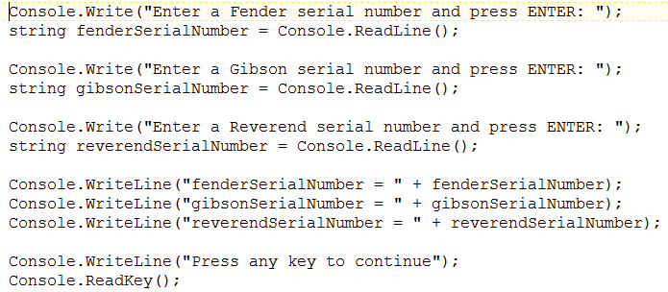
Input and Output – 3b Screen Capture
Enter the code below or copy and paste it from the next slide

Slide 25
Input and Output – 3c Copyable Code
Console.Write("Enter a Fender serial number and press ENTER: ");
string fenderSerialNumber = Console.ReadLine();
Console.Write("Enter a Gibson serial number and press ENTER: ");
string gibsonSerialNumber = Console.ReadLine();
Console.Write("Enter a Reverend serial number and press ENTER: ");
string reverendSerialNumber = Console.ReadLine();
Console.WriteLine("fenderSerialNumber = " + fenderSerialNumber);
Console.WriteLine("gibsonSerialNumber = " + gibsonSerialNumber);
Console.WriteLine("reverendSerialNumber = " + reverendSerialNumber);
Console.WriteLine("Press any key to continue");
Console.ReadKey();

Slide 26
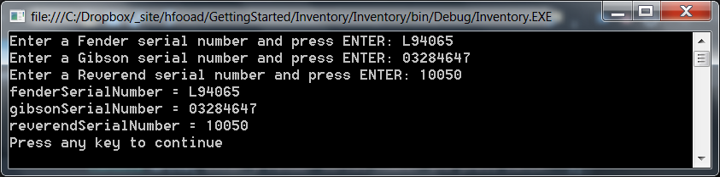
Input and Output – 3d Output
Start the program and enter serial numbers to be assigned to the fenderSerialNumber, gibsonSerialNumber and reverendSerialNumber variables

Slide 27
See Introduction to Classes 2.pptx

